Slide 1
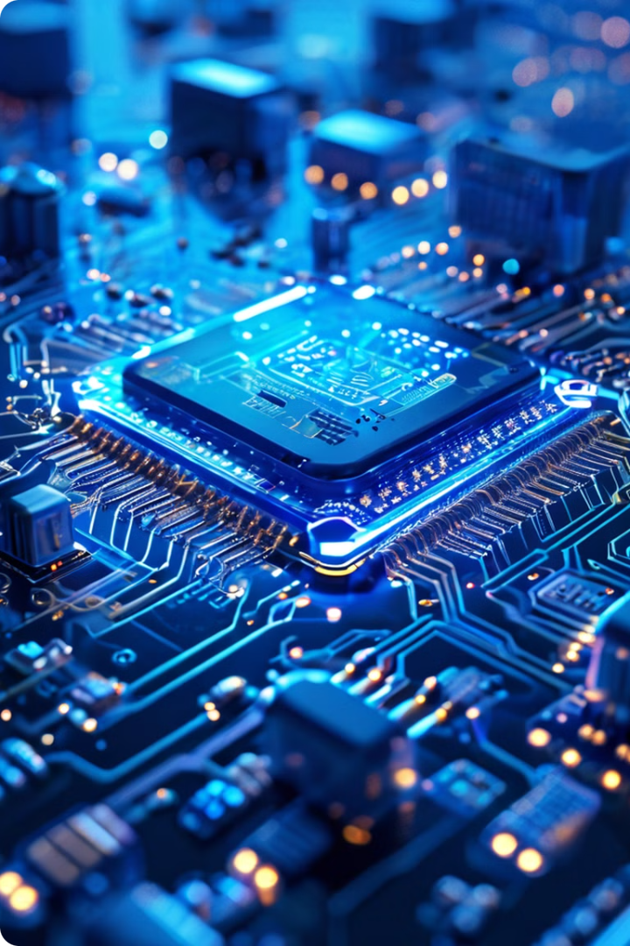


Embedded Systems: The Foundations
Embedded systems are specialized computing devices that are integrated into larger mechanical or electrical systems, designed to perform dedicated functions. These systems are characterized by their real-time operation, power and size constraints, and the need for high reliability. Implementing embedded systems involves both hardware and software development, with a focus on firmware - the low-level software that interacts directly with the hardware to control system operations.
by Mostafa AboSalama

Slide 2
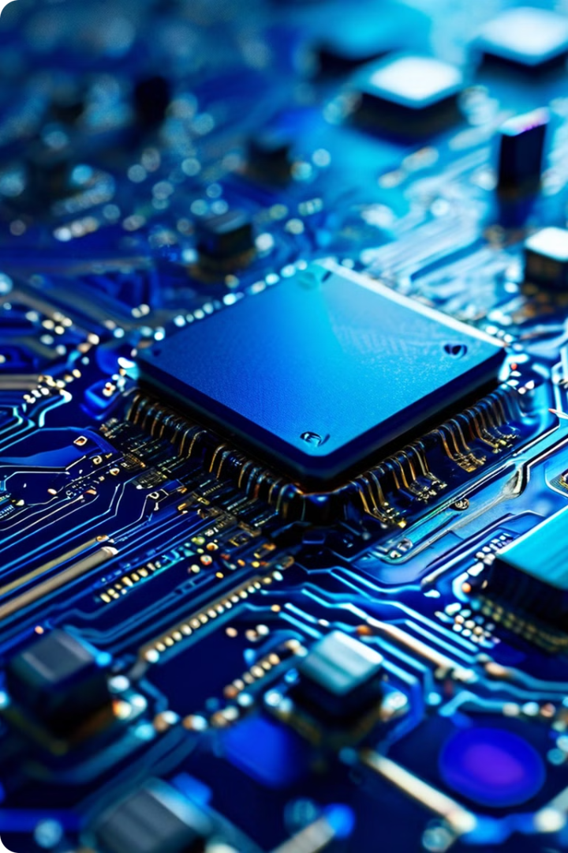
System Boards and SoCs
The heart of an embedded system is the system board, or motherboard, which houses the CPU, memory, and other critical components. An alternative is the System-on-Chip (SoC), which integrates all these components into a single chip, reducing size and power consumption while enhancing performance and reliability. Embedded systems also rely on a variety of specialized processors, including microprocessors (MPUs), microcontrollers (MCUs), graphics processing units (GPUs), and digital signal processors (DSPs).

Slide 3
Processor Fundamentals
Key Components
Instruction Decoders
Instruction Lifecycle
The core components of a processor include the Arithmetic Logic Unit (ALU), Control Unit (CU), registers, cache, and buses. These work together to fetch, decode, and execute instructions, forming the foundation of a processor's operation.
The instruction decoder is responsible for interpreting the binary instructions fetched from memory and signaling the necessary operations. There are two main approaches: hard-wired decoders, which use fixed logic circuits, and memory-mapped decoders, which use more flexible memory locations to specify instruction operations.
The instruction lifecycle in a processor involves continuously fetching instructions from memory, decoding them, executing the required operations, and writing back the results. This cycle is repeated over and over, driving the processor's functionality.

Slide 4
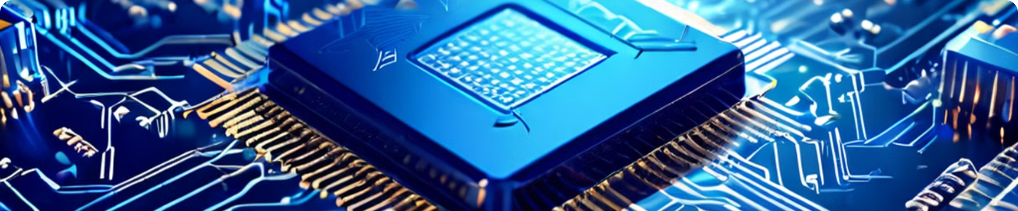
RISC vs. CISC
1
RISC (Reduced Instruction Set Computing)
2
CISC (Complex Instruction Set Computing)
RISC processors use a small, highly optimized set of instructions, simplifying the instruction set and allowing for faster execution.
CISC processors use a comprehensive set of instructions, aiming to complete tasks in fewer lines of assembly code, but often require multiple cycles per instruction.

Slide 5
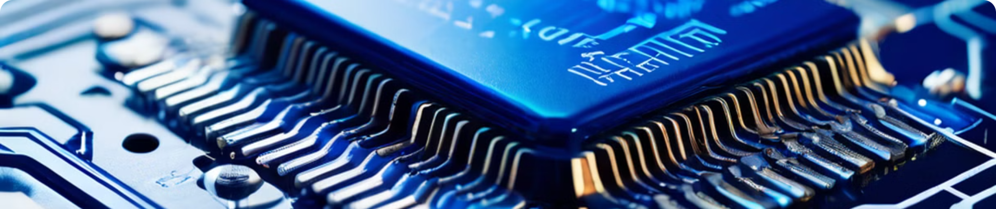
Register Files
General Purpose Registers (GPRs)
Special Purpose Registers (SPRs)
GPRs are used to hold temporary data and intermediate results during program execution.
SPRs are used for specific functions, such as stack pointers, program counters, and status registers.

Slide 6

Memory Types
EEPROM and Flash
ROM
Electrically Erasable Programmable Read-Only Memory, used for storing data that needs to be retained when power is turned off.
Read-Only Memory, used for storing firmware and other non-volatile data.
1
2
3
RAM
Random Access Memory, used for temporary storage and quick read/write access.

Slide 7
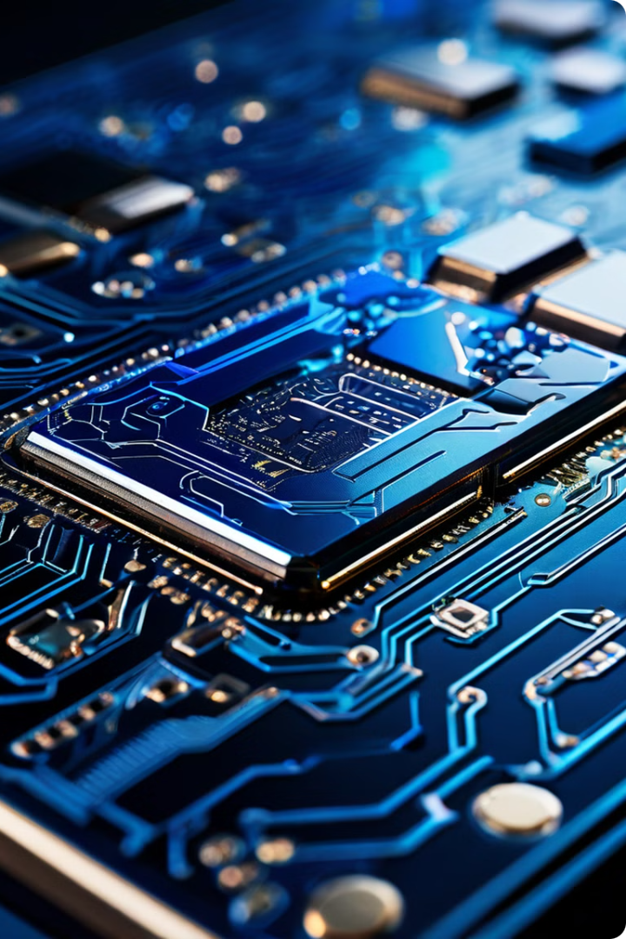



Memory Fundamentals
Flip-Flops
The basic digital memory circuit that can store one bit of information.
SRAM
Static RAM, faster and more expensive, does not need periodic refreshing.
DRAM
Dynamic RAM, slower and cheaper, requires periodic refreshing to maintain data.

Slide 8




Volatile Memory
RAM
RAM is a type of volatile memory, meaning it loses its data when power is turned off. It is used for temporary storage while a system is running, allowing for quick read and write access.
Volatility
Volatile memory requires a constant power supply to maintain its data, in contrast to non-volatile memory like ROM and Flash, which can retain data even when power is turned off.
Applications
Volatile memory is essential for embedded systems, providing the temporary storage needed for real-time operation and system responsiveness.

